Slide 1

Waterfall Week 3 Presentation

Slide 2
Design
Level 0 data flow diagram
Level 1 data flow diagrams
Class UMLs

Slide 3
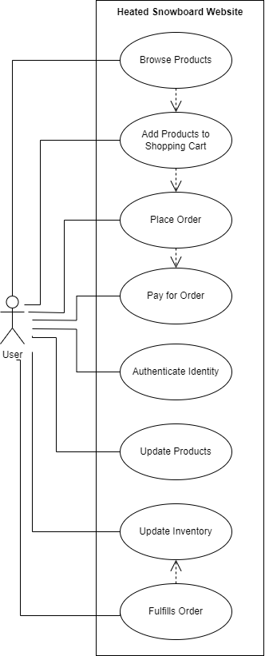
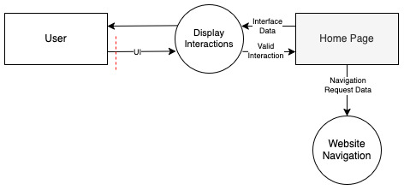
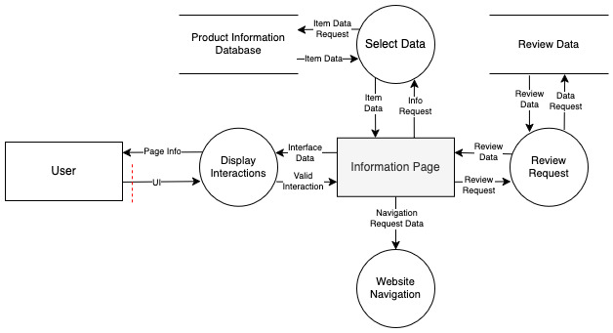


Slide 4

Security
Input Validation
Each interactive element within the website performs one specific task to ensure users do not overload the system.
Users are limited to specific actions within the website.
Users will not be allowed to cause any form of request overloading.
Users will have select elements that may be interacted with. Any other elements will remain unresponsive should users attempt to interact with them.

Slide 5

Infrastructure
Docker file to run nginx to deploy all HTML, CSS, and JavaScript within the repository
Docker YAML file setup as an app on TrueNas server to self host our website
Cloudflare domain to make website available to the public

